Slide 1
Motion and
Optical Flow

Slide 2
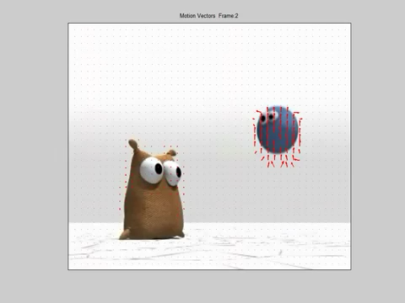
https://www.youtube.com/watch?v=BDtvjKMl30w

Slide 3
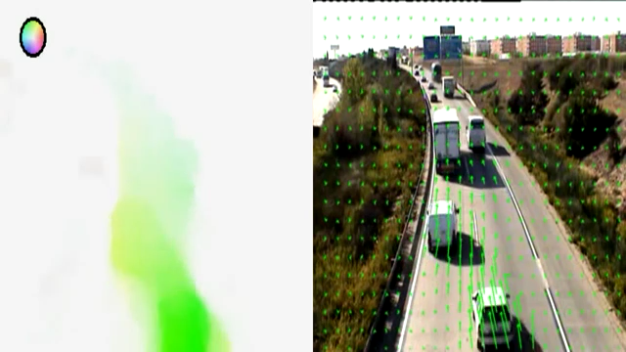
https://www.youtube.com/watch?v=5rR_9YIcg_s

Slide 4
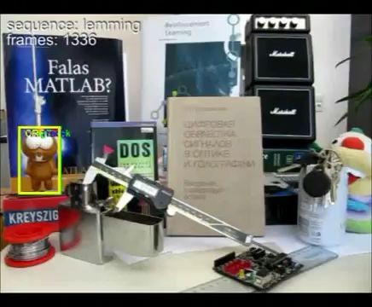
Plan
Motion Field
Patch-based / Direct Motion Estimation
External Resource:
Mubarak Shah’s lecture on optical flow
http://www.youtube.com/watch?v=5VyLAH8BhF8

Slide 5
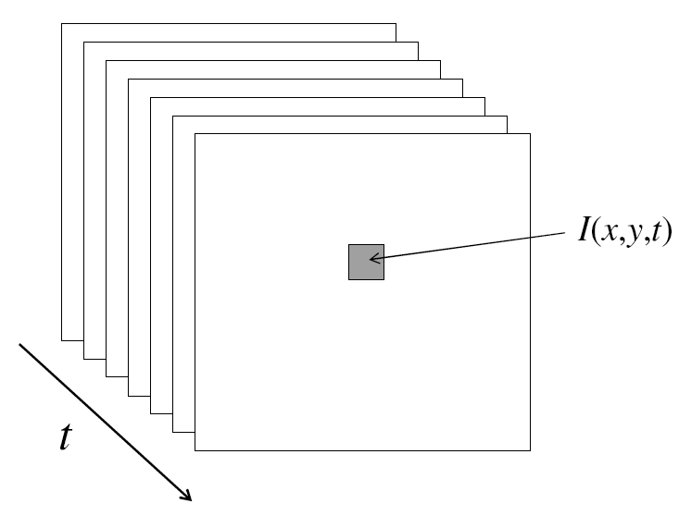
Video
A video is a sequence of frames captured over time
Now our image data is a function of space (x, y) and time (t)
Slide adapted from K. Grauman.

Slide 6
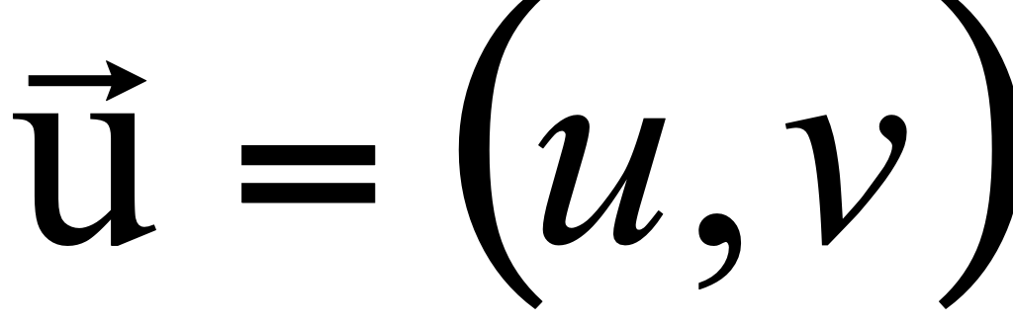
Motion Field & Optical Flow Field
Motion Field = Real world 3D motion
Optical Flow Field = Projection of the motion field onto the 2d image
CCD
3D motion vector
2D optical flow vector
Slide adapted from Savarese.

Slide 7
Motion field and Parallax
P(t) is a moving 3D point
Velocity of scene point: V = dP/dt
p(t) = (x(t),y(t)) is the projection of P in the image
Apparent velocity v in the image: given by components v_{x} = dx/dt and v_{y} = dy/dt
These components are known as the motion field of the image
P(t+dt)
P(t)
V
v
p(t+dt)
p(t)
Slide adapted from K. Grauman.

Slide 8
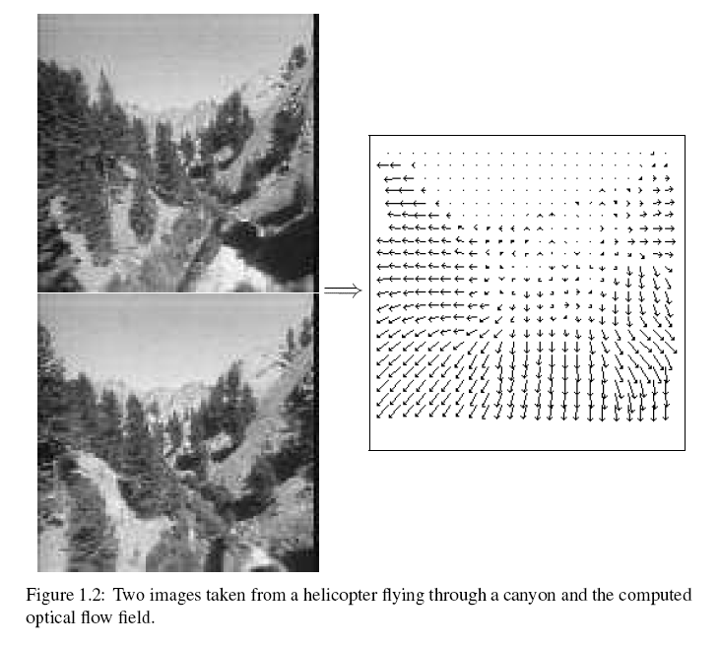
Motion field + camera motion
Length of flow vectors inversely proportional to depth Z of 3d point
points closer to the camera move more quickly across the image plane
Figure from Michael Black, Ph.D. Thesis
Slide adapted from K. Grauman.

Slide 9
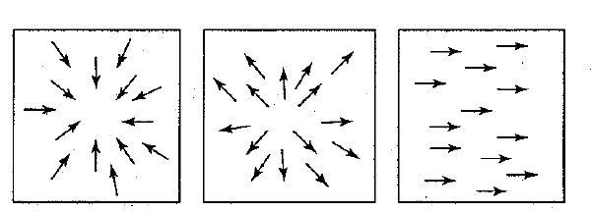
Motion field + camera motion
Zoom out
Zoom in
Pan right to left
Slide adapted from Savarese and Grauman.

Slide 10
Motion estimation techniques
Feature-based methods
Extract visual features (corners, textured areas) and track them over multiple frames
Sparse motion fields, but more robust tracking
Suitable when image motion is large (10s of pixels)
Direct methods
Directly recover image motion at each pixel from spatio-temporal image brightness variations
Dense motion fields, but sensitive to appearance variations
Suitable for video and when image motion is small
Slide adapted from K. Grauman.

Slide 11
What we will learn today?
Optical flow
Lucas-Kanade method
Horn-Schunk method
Applications
28-Nov-17

Slide 12
Optical Flow
Definition: optical flow is the apparent motion of brightness patterns in the image
Note: apparent motion can be caused by lighting changes without any actual motion
Think of a uniform rotating sphere under fixed lighting vs. a stationary sphere under moving illumination
GOAL: Recover image motion at each pixel from optical flow
Source: Silvio Savarese
28-Nov-17

Slide 13
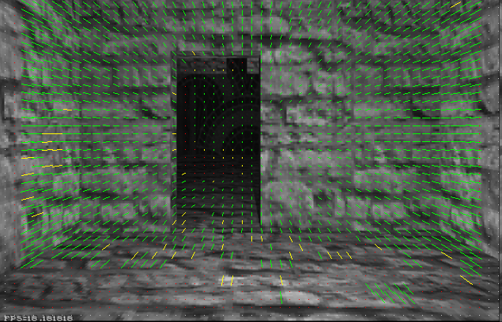
Optical Flow
Vector field function of the spatio-temporal image brightness variations
Picture courtesy of Selim Temizer - Learning and Intelligent Systems (LIS) Group, MIT
28-Nov-17

Slide 14
Estimating Optical Flow
I(x,y,t–1)
I(x,y,t)
Given two subsequent frames, estimate the apparent motion field u(x,y), v(x,y) between them
Key assumptions
Brightness constancy: projection of the same point looks the same in every frame
Small motion: points do not move very far
Spatial coherence: points move like their neighbors
Source: Silvio Savarese
28-Nov-17

Slide 15
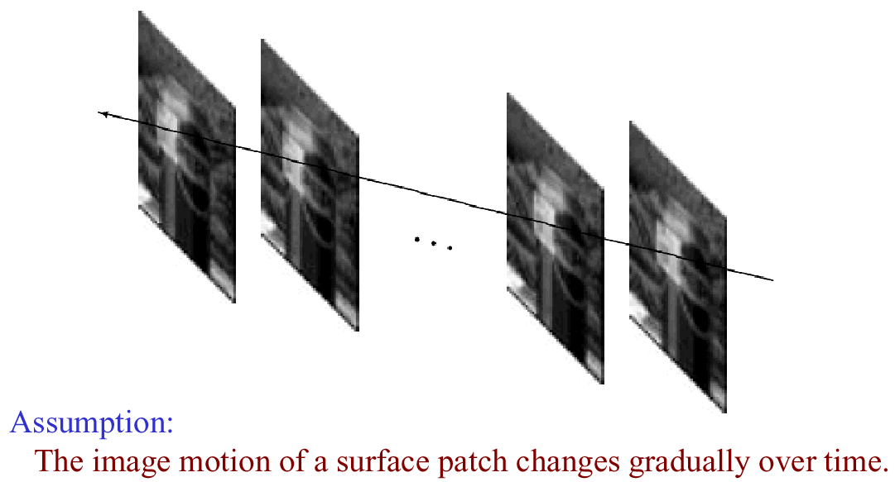
Key Assumptions: Small Motions
* Slide from Michael Black, CS143 2003

Slide 16
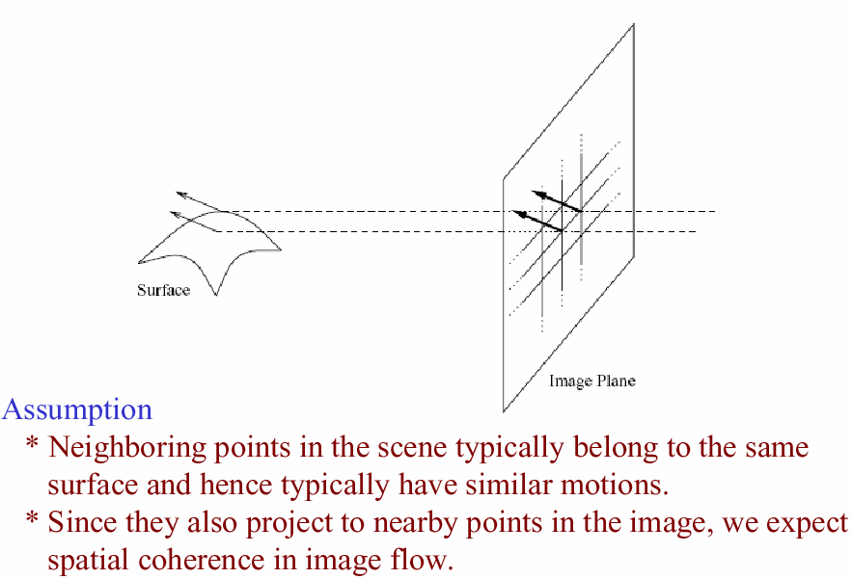
Key Assumptions: Spatial Coherence
* Slide from Michael Black, CS143 2003

Slide 17
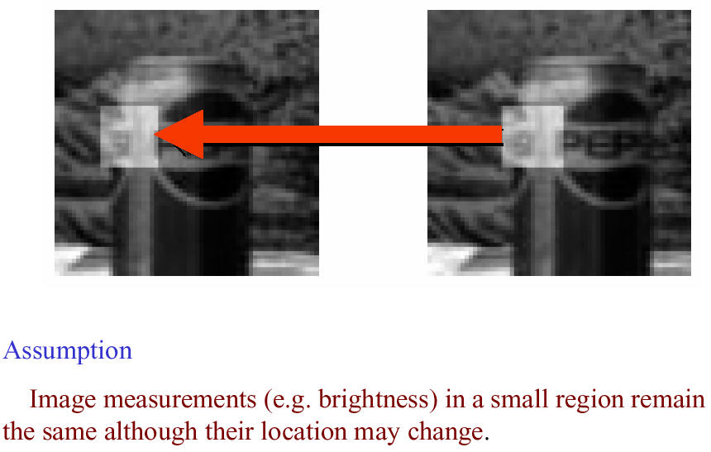
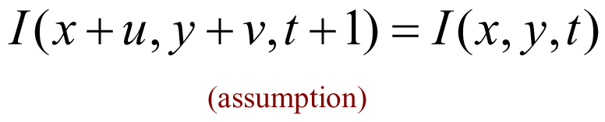
Key Assumptions: Brightness Constancy
* Slide from Michael Black, CS143 2003

Slide 18
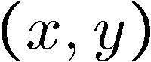
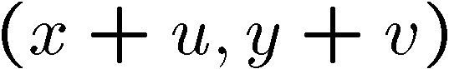
The Brightness Constancy Constraint
I(x,y,t–1)
I(x,y,t)
Brightness Constancy Equation:
Linearizing the right side using Taylor expansion:
Source: Silvio Savarese
28-Nov-17

Slide 19

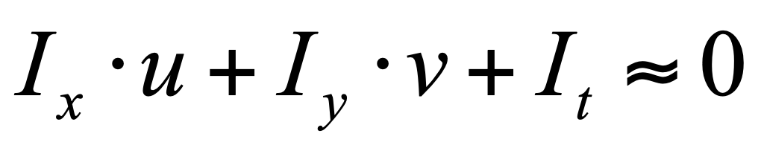
The Brightness Constancy Constraint
I(x,y,t–1)
I(x,y,t)
Brightness Constancy Equation:
Linearizing the right side using Taylor expansion:
Image derivative along x
Source: Silvio Savarese
Hence,
28-Nov-17

Slide 20
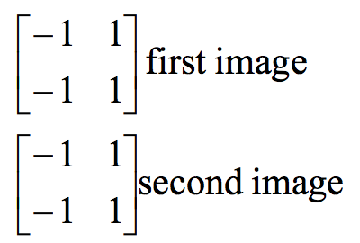
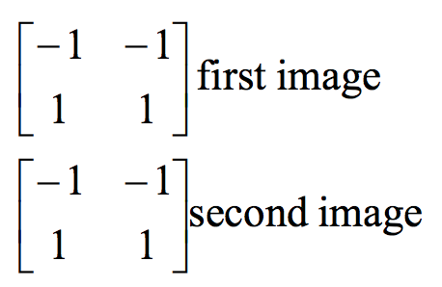
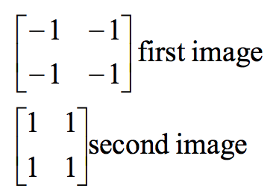
Filters used to find the derivatives
$$I_{x}$$
$$I_{y}$$
$$I_{t}$$
28-Nov-17

Slide 21
The brightness constancy constraint
Can we use this equation to recover image motion (u,v) at each pixel?
How many equations and unknowns per pixel?
One equation (this is a scalar equation!), two unknowns (u,v)
Source: Silvio Savarese
28-Nov-17
Notes:
A: u and v are unknown, 1 equation

Slide 22
The brightness constancy constraint
Can we use this equation to recover image motion (u,v) at each pixel?
How many equations and unknowns per pixel?
One equation (this is a scalar equation!), two unknowns (u,v)
The component of the flow perpendicular to the gradient (i.e., parallel to the edge) cannot be measured
gradient
(u,v)
If (u, v ) satisfies the equation, so does (u+u’, v+v’ ) if
(u+u’,v+v’)
Source: Silvio Savarese
(u’,v’)
edge
28-Nov-17
Notes:
A: u and v are unknown, 1 equation

Slide 23
What we will learn today?
Optical flow
Lucas-Kanade method
Horn-Schunk method
Applications
Reading: [Szeliski] Chapters: 8.4, 8.5
[Fleet & Weiss, 2005]
http://www.cs.toronto.edu/pub/jepson/teaching/vision/2503/opticalFlow.pdf
28-Nov-17

Slide 24
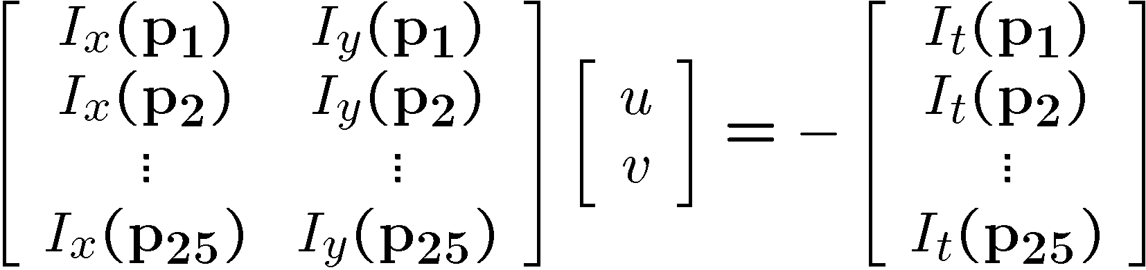
Solving the ambiguity…
B. Lucas and T. Kanade. An iterative image registration technique with an application to stereo vision. In Proceedings of the International Joint Conference on Artificial Intelligence, pp. 674–679, 1981.
How to get more equations for a pixel?
Spatial coherence constraint:
Assume the pixel’s neighbors have the same (u,v)
If we use a 5x5 window, that gives us 25 equations per pixel
Source: Silvio Savarese
28-Nov-17

Slide 25
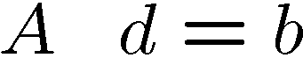
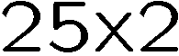
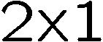
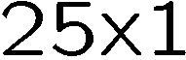
Lucas-Kanade flow
Over-constrained linear system:
Source: Silvio Savarese
28-Nov-17

Slide 26
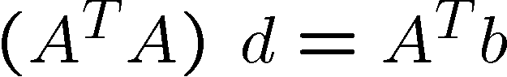
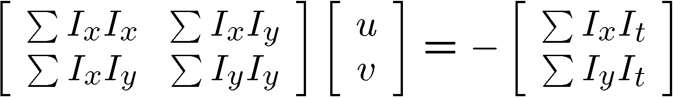
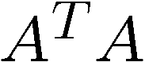
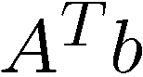
Lucas-Kanade flow
Overconstrained linear system
Least squares solution for d given by
Source: Silvio Savarese
The summations are over all pixels in the K x K window
28-Nov-17

Slide 27
Conditions for solvability
Optimal (u, v) satisfies Lucas-Kanade equation
When is This Solvable?
A^{T}A should be invertible
A^{T}A should not be too small due to noise
eigenvalues λ₁ and λ ₂ of A^{T}A should not be too small
A^{T}A should be well-conditioned
λ ₁/ λ ₂ should not be too large (λ ₁ = larger eigenvalue)
Source: Silvio Savarese
Does this remind anything to you?
28-Nov-17

Slide 28
Interpreting the eigenvalues
Classification of image points using eigenvalues of the second moment matrix:
λ₂
“Edge” λ₂ >> λ₁
“Corner” λ₁ and λ₂ are large, λ₁ ~ λ₂
λ₁ and λ₂ are small
“Flat” region
“Edge” λ₁ >> λ₂
λ₁
28-Nov-17

Slide 29
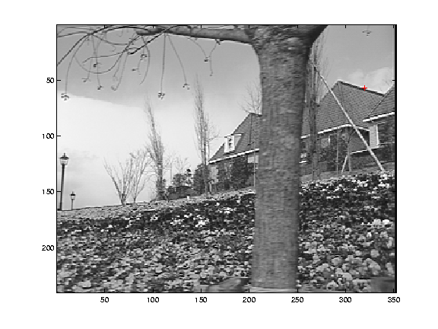
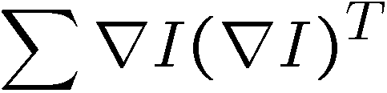
Edge
Source: Silvio Savarese
gradients very large or very small
large λ₁, small λ₂
28-Nov-17

Slide 30
Low-texture region
Source: Silvio Savarese
gradients have small magnitude
small λ₁, small λ₂
28-Nov-17

Slide 31
High-texture region
Source: Silvio Savarese
gradients are different, large magnitudes
large λ₁, large λ₂
28-Nov-17

Slide 32
Errors in Lukas-Kanade
What are the potential causes of errors in this procedure?
Suppose A^{T}A is easily invertible
Suppose there is not much noise in the image
When our assumptions are violated
Brightness constancy is not satisfied
The motion is not small
A point does not move like its neighbors
window size is too large
what is the ideal window size?
* From Khurram Hassan-Shafique CAP5415 Computer Vision 2003

Slide 33
Errors in Lukas-Kanade
Examples:
1. A uniform rotating sphere
– nothing seems to move, yet it is rotating
2. Changing directions or intensities of lighting can make things seem to move
– for example, if the specular highlight on a rotating sphere moves.
28-Nov-17

Slide 34
Iterative Refinement
Iterative Lukas-Kanade Algorithm
Estimate velocity at each pixel by solving Lucas-Kanade equations
Warp I(t-1) towards I(t) using the estimated flow field
- use image warping techniques
Repeat until convergence
* From Khurram Hassan-Shafique CAP5415 Computer Vision 2003

Slide 35
What we will learn today?
Optical flow
Lucas-Kanade method
Horn-Schunk method
Applications
Reading: [Szeliski] Chapters: 8.4, 8.5
[Fleet & Weiss, 2005]
http://www.cs.toronto.edu/pub/jepson/teaching/vision/2503/opticalFlow.pdf
28-Nov-17

Slide 36
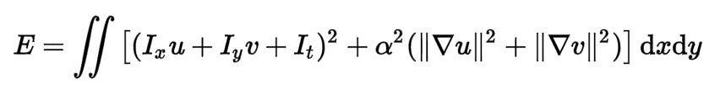
Horn-Schunk method for optical flow
The flow is formulated as a global energy function which should be minimized:
28-Nov-17

Slide 37
Horn-Schunk method for optical flow
The flow is formulated as a global energy function which should be minimized:
The first part of the function is the brightness consistency.
Recall: we derived
u and v are both functions defined on the image
28-Nov-17

Slide 38
Horn-Schunk method for optical flow
Vector field function of the spatio-temporal image brightness variations
Picture courtesy of Selim Temizer - Learning and Intelligent Systems (LIS) Group, MIT
28-Nov-17

Slide 39
Horn-Schunk method for optical flow
The flow is formulated as a global energy function which is should be minimized:
The second part is the smoothness constraint. It’s trying to make sure that the changes between frames are small.
28-Nov-17

Slide 40
Horn-Schunk method for optical flow
The flow is formulated as a global energy function which is should be minimized:
is a regularization constant. Larger values of lead to smoother flow.
28-Nov-17

Slide 41
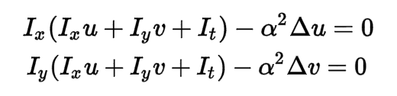
Horn-Schunk method for optical flow
The flow is formulated as a global energy function which is should be minimized:
To minimize E, we can solve the following equalities (“Dirichlet energy” minimization <=> solving a variational problem, advanced math, not required)
28-Nov-17

Slide 42
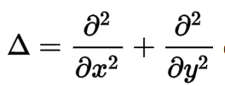
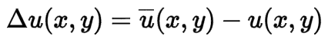
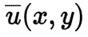
Horn-Schunk method for optical flow
Where is called the Laplace operator. In practice, it is measured using:
where is the weighted average of u measured at (x,y).
28-Nov-17

Slide 43
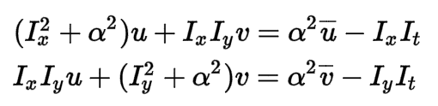
Horn-Schunk method for optical flow
Now we substitute in:
To get:
Which is linear in u and v and can be solved for each pixel individually.
28-Nov-17

Slide 44
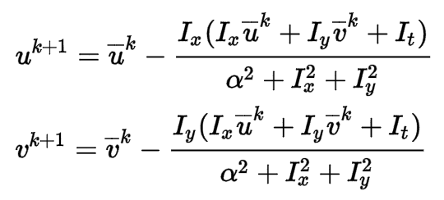
Iterative Horn-Schunk
But since the solution depends on the neighboring values of the flow field, it must be repeated once the neighbors have been updated.
So instead, we can iteratively solve for u and v using:
28-Nov-17

Slide 45
What we will learn today?
Optical flow
Lucas-Kanade method
Horn-Schunk method
Applications
28-Nov-17

Slide 46
Uses of motion
Tracking features
Segmenting objects based on motion cues
Learning dynamical models
Improving video quality
Motion stabilization
Super resolution
Tracking objects
Recognizing events and activities
28-Nov-17

Slide 47
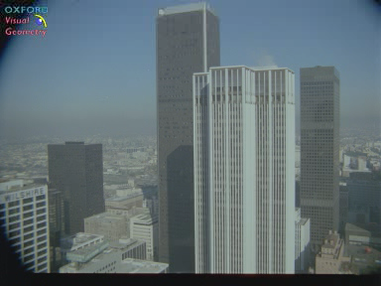
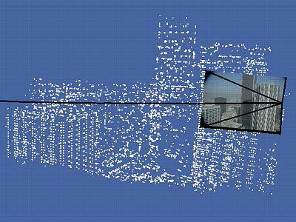
Estimating 3D structure
Source: Silvio Savarese
28-Nov-17

Slide 48
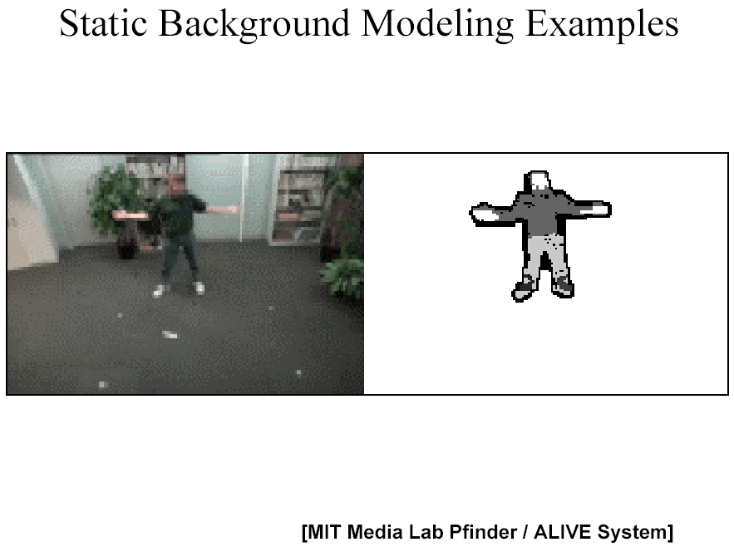
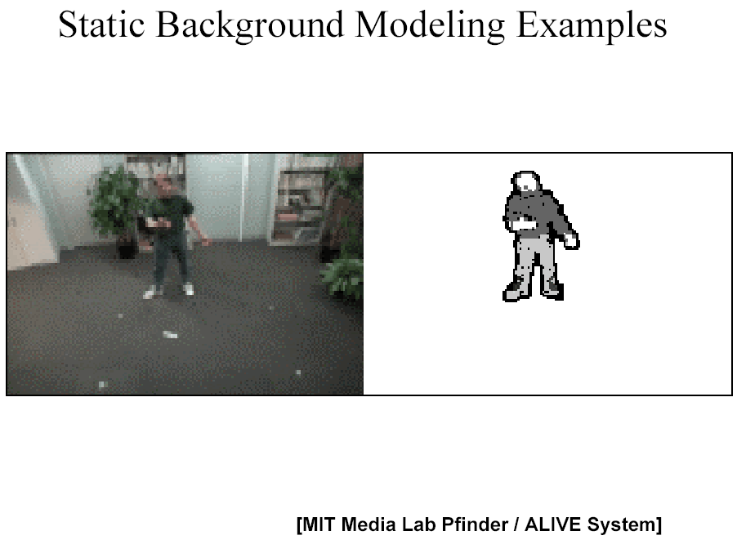
Segmenting objects based on motion cues
Background subtraction
A static camera is observing a scene
Goal: separate the static background from the moving foreground
Source: Silvio Savarese
28-Nov-17

Slide 49
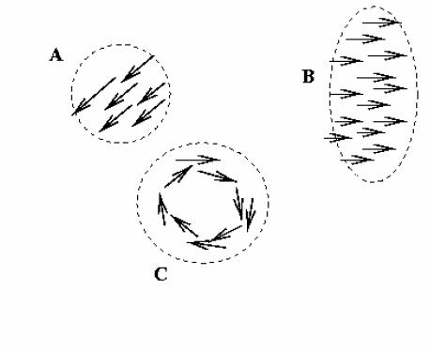
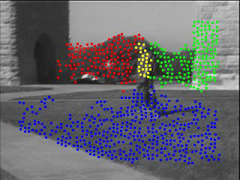
Segmenting objects based on motion cues
Motion segmentation
Segment the video into multiple coherently moving objects
Source: Silvio Savarese
S. J. Pundlik and S. T. Birchfield, Motion Segmentation at Any Speed, Proceedings of the British Machine Vision Conference (BMVC) 2006
28-Nov-17

Slide 50
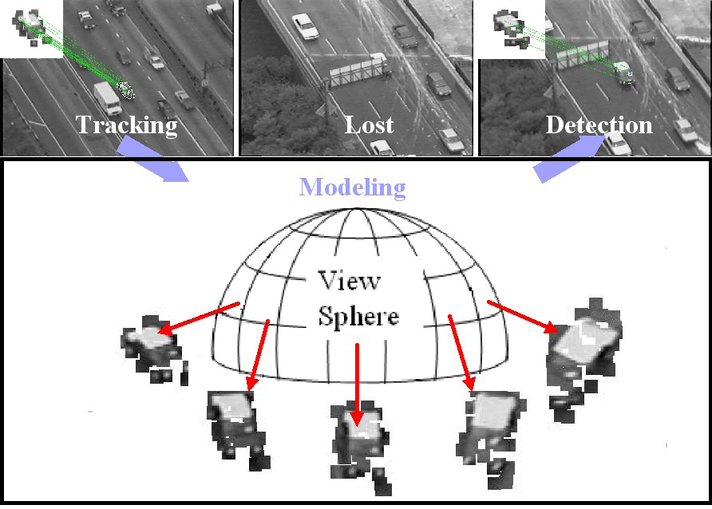
Tracking objects
Source: Silvio Savarese
Z.Yin and R.Collins, "On-the-fly Object Modeling while Tracking," IEEE Computer Vision and Pattern Recognition (CVPR '07), Minneapolis, MN, June 2007.
28-Nov-17

Slide 51
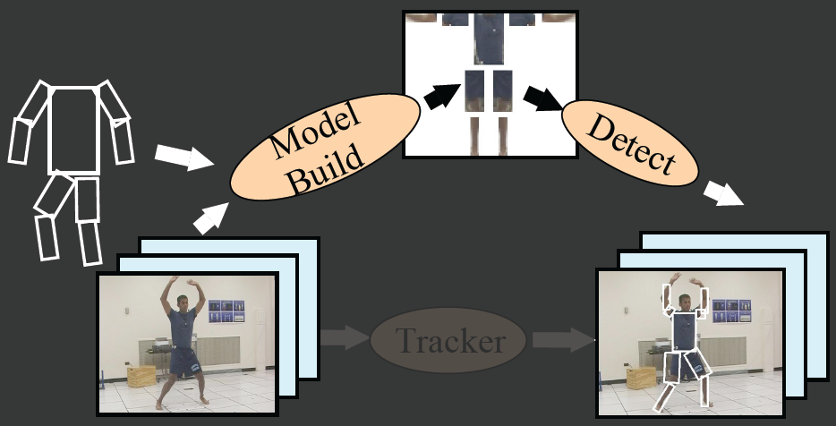
Recognizing events and activities
Tracker
Source: Silvio Savarese
D. Ramanan, D. Forsyth, and A. Zisserman. Tracking People by Learning their Appearance. PAMI 2007.
28-Nov-17

Slide 52
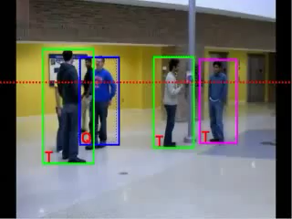
Recognizing events and activities
Crossing – Talking – Queuing – Dancing – jogging
Source: Silvio Savarese
W. Choi & K. Shahid & S. Savarese WMC 2010
28-Nov-17
Notes:
15’ from last point

Slide 53
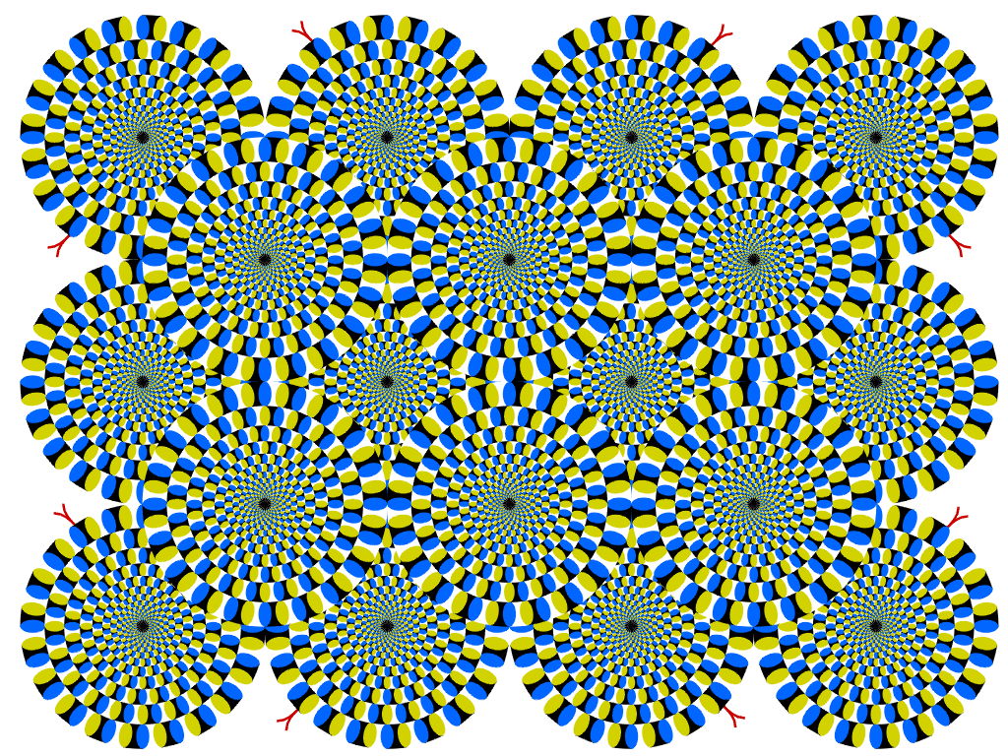
Optical flow without motion!
28-Nov-17

